Slide 1
Electronic Devices
Mid Term Lecture - 10
Reference book:
Electronic Devices and Circuit Theory
Robert L. Boylestad and L. Nashelsky , (11th Edition)

Slide 2
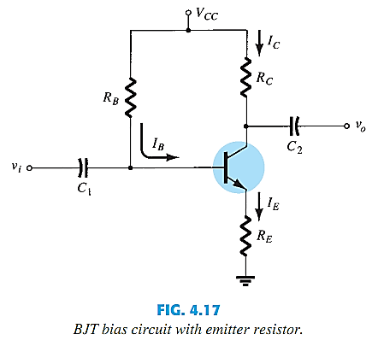
EMITTER-BIAS CONFIGURATION
Adding a resistor in the Emitter circuit stabilizes the bias circuit.

Slide 3
BIAS STABILITY
Adding R_{E} to the Emitter improves the stability of a transistor.
Stability refers to a bias circuit in which the currents and voltages will remain constant for a while range of temperatures and transistor Beta’s (β).

Slide 4
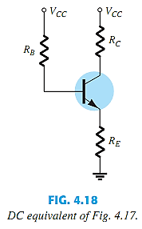
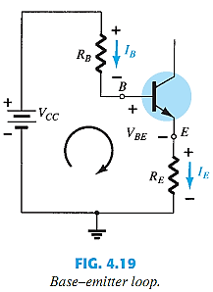
BASE–EMITTER LOOP

Slide 5
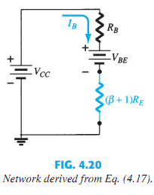




BASE–EMITTER LOOP

Slide 6

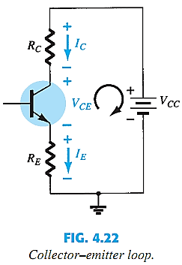
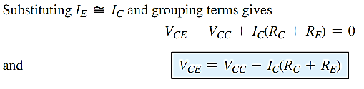


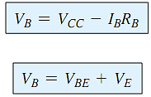
COLLECTOR–EMITTER LOOP

Slide 7

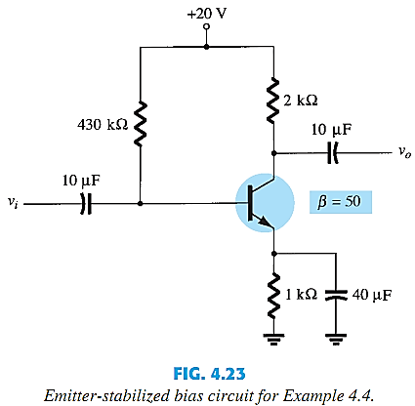
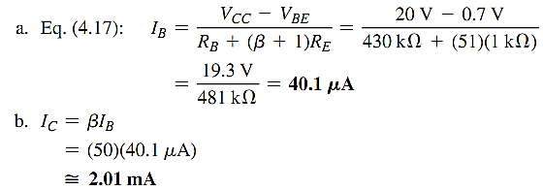
EXAMPLE

Slide 8


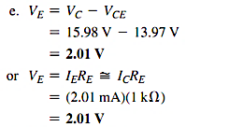


EXAMPLE

Slide 9
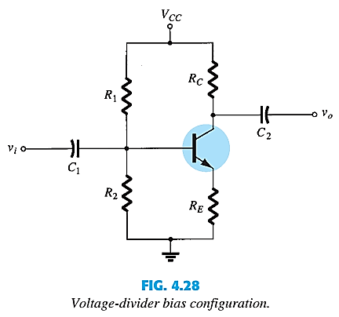
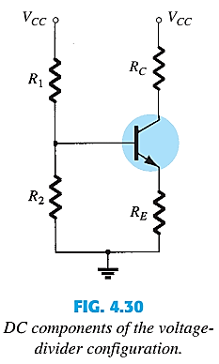
VOLTAGE-DIVIDER BIAS CONFIGURATION

Slide 10
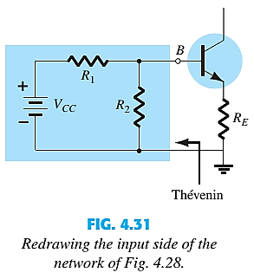






Slide 11
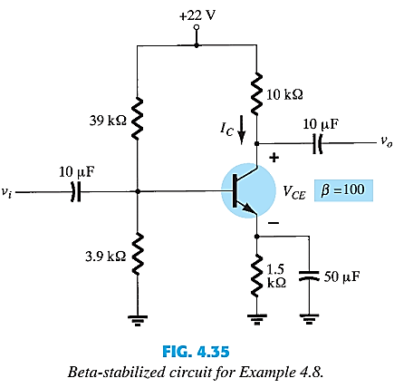
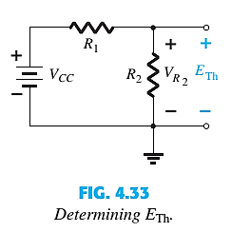

EXAMPLE

Slide 12
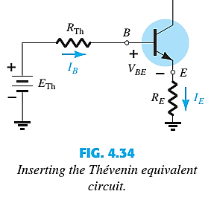
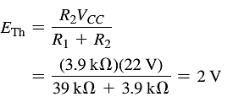


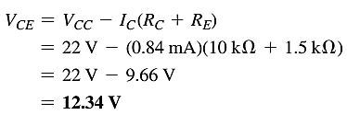

EXAMPLE CONTD.

Slide 13
Thank You

